Slide 1

Context diagram
PHÂN TÍCH VÀ THIẾT KẾ HƯỚNG ĐỐI TƯỢNG
Thực hành 1
Notes:
NOTE:
To change the image on this slide, select the picture and delete it. Then click the Pictures icon in the placeholder to insert your own image.

Slide 2
Context diagram
The first diagram that you need on any project
UML does not have a context diagram (➔ use the use-case diagram)
You have to know the answers to the following questions:
Who uses your system?
What data must go into your system?
What information and objects must your system produce as output to users and other systems?
The diagram helps define the boundaries of your system

Slide 3
The steps to construct such a diagram
Place a large rectangle in the center of the diagram.
Place the name of the system at top-center, just inside the rectangle
Identify and name each of the actors that you expect to interact with your system
Place the actors around the outside of the rectangle representing your system
Draw a line between the actor and the system rectangle
Show the information, data, and/or objects that flow into your system from an actor above the line connecting that actor to the system.
Show the information, data, and/or objects that flow out of your system to an actor below the line connecting that actor to the system
Repeat Steps 6 and 7 for each actor that sends data into the system or receives data from the system.

Slide 4
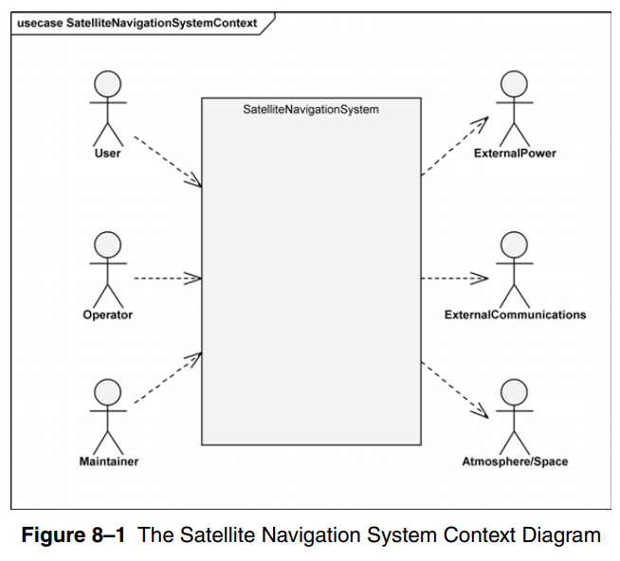
Example: SYSTEM ARCHITECTURE: SATELLITE-BASED NAVIGATION

Slide 5
PowerDesign
Vẽ context diagram cho Hệ thống đặt hàng sản phẩm
Khách hàng
Kế toán
Người quản lý
Thủ kho

Slide 6
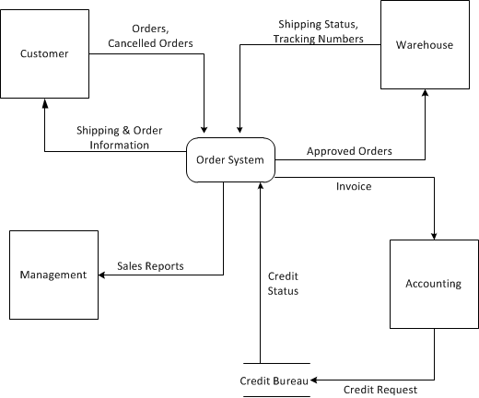

Slide 7
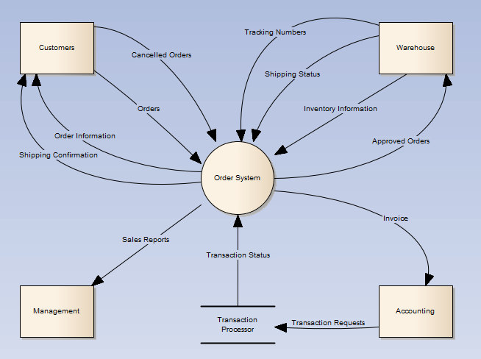

Slide 8
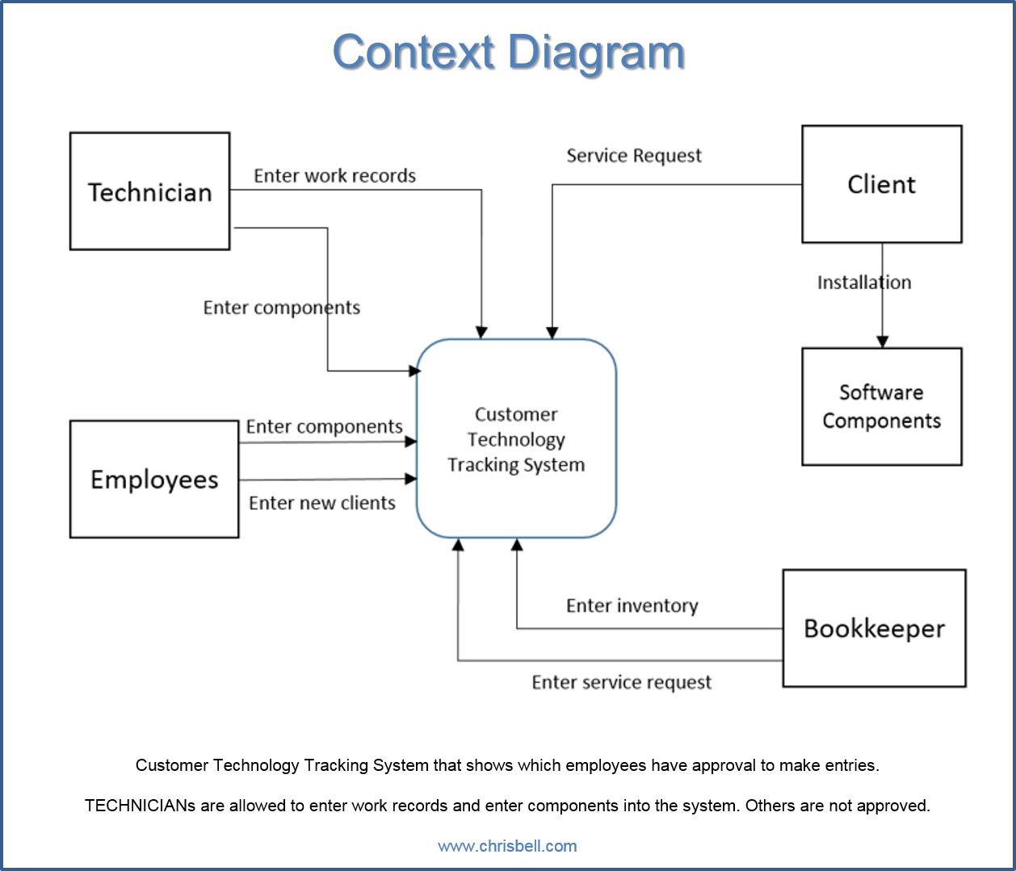

Slide 9
Vẽ Context Diagram
Hệ thống quản lý thiết bị

